Slide 1

SCHIZOPHRENIA SPECTRUM DISORDERS
PAUL M. MWOVE
MSCN (UON) /BsCN/KRPN/KRM/KRN.
PSYCHIATRY AND MENTAL HEALTH NURSE SPECIALIST.

Slide 2
OUTLINE
1.Introduction
-Definition.
-Epidemiology
2.Clinical features of schizophrenia.
3.Aetiology/Causes of schizophrenia.
5.Schizophrenia:ICD -10 & DSM 5
-Subtypes of schizophrenia.
-DSM 5 Diagnostic Criteria.
7.Assessment/Management of Schizophrenia.
8.Nursing care plan.

Slide 3
INTRODUCTION
Word schizophrenia is derived from Greek word literally meaning “ split mind” and was coined by Eugen Bleurer in 1908.
“Schizo” =Split
“Phren” =Mind
Previous term for the illness was Dementia Praecox popularized by German psychiatrist Emil kraepelin.

Slide 4
Introduction: Schizophrenia cont…
Definition:- ”SPLIT MIND”
Disorder of the brain producing disturbances in:- reality, thought process and social development (Johnson, 1993);
Persistent, long term mental llness with alternating periods of exacerbation and remission
No single symptom is diagnostic of schizophrenia;

Slide 5
Cont.….Introduction..
The schizophrenias are severe and persistent neurological diseases.
These serious disorders affect a person’s:-
Perceptions (hallucinations, illusions).
Thinking (delusions, paranoia, disorganized thinking).
Language/speech (associative looseness, poverty of speech).
Emotions (apathy, anhedonia, lack of motivation, depression).
Social behavior (aggressive, bizarre behaviours or extreme social withdrawal)

Slide 6
Epidemiology
Life-time prevalence is about 1%
Annual incidence is about 0.2 per 1000.
Incidence varies between nations(natives vs. immigrants), and within cities (urban vs. rural)
Life-time risk is about 40% higher in males than in females.
Peak age of onset is 15 to 24 years in males and 25 to 30 years in females(5 – 10 years later).
Females have a second peak at 55 to 64 years.

Slide 7
EPIDEMIOLOGY CONT….
Suicide
Common cause of death in schizophrenia
50% attempt suicide at least once in a lifetime
Co morbid Substance Abuse
Significant
Financial Cost
1% of USA national income goes for the treatment of mental illness (excluding substance abuse).
The majority of this amount is related to direct and indirect costs of schizophrenia

Slide 8
Neuro anatomy.
The major brain areas affected in schizophrenia are the limbic structures, the frontal lobes, and the basal ganglia.
1).Limbic system:
Hypothesized to be involved in pathophysiological basis of schizophrenia because of its role in the control of emotions.

Slide 9
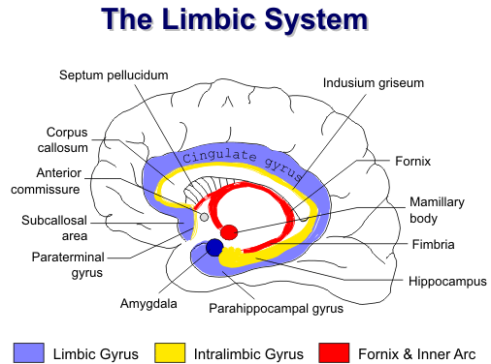

Slide 10
Neuro anatomy cont…
2).Basal ganglia:
Regulates body movement and integrates sensory movement.
Many patients with schizophrenia have odd movements, even in the absence of medication-induced disorders (for example: awkward gait, facial grimace).

Slide 11
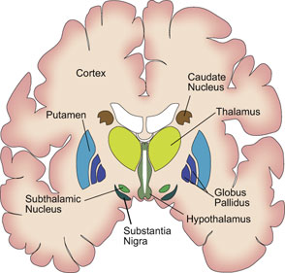
BASAL GANGLIA

Slide 12
Neuro anatomy cont…
3).Frontal lobe:
Aids in planning for the future, motivation, control of voluntary motor function, production of speech.
Plays important part in emotional experience and expression of mood
Modulates various aspects of thinking, feeling, imagining, decision making.
Responsible for intellectual functioning with responsibility for judgment, reasoning and abstract thought.

Slide 13
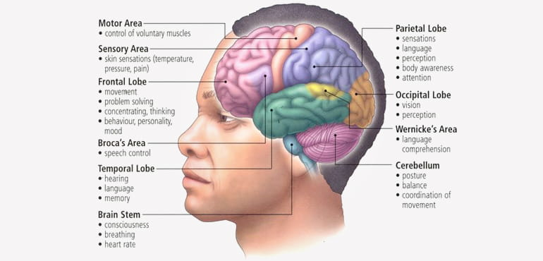
Parts of brain and function.

Slide 14
Clinical features of schizophrenia.
Schizophrenia is a psychotic disorder.
A psychotic disorder is a condition in which the patient has experiences/believes that do not have basis in reality.
The 2 main psychotic features are:-
i):-Hallucinations.
ii):-Delusions.
Hallucinations.
A sensory perception in the absence of a sensory stimulus.
Can occur in any of the 5 sensory modalities/senses:-Eyes/visual, somatic/tactile, smell/olfactory and taste/gustatory.

Slide 15
Clinical features of schizophrenia cont.…
Hallucinations can be:-
2nd person :-Talking directly to the patient OR
3rd Person:-Talking about the patient(Running commentally).
Delusions.
A delusion is a force, fixed believe held by the patient with absolute conviction, despite evidence to the contrary, and not shared by others from the patients family or culture or educational level.
In schizophrenia, delusions normally have various themes:-
i):-a persecutory theme.
Example:- ”My neighbor is trying to poison me”
ii):-grandiose theme. Example:- “I am Jesus” etc…

Slide 16
Positive and negative symptoms of schizophrenia.
Positive symptoms:-They include:-
i):-Hallucinations.
ii):-Delusions
iii):-Disorganized speech:
-word salad/neologisms
-monosyllabic speech.
iv):-Disorganized behavior:- Bizarre, No purpose behaviors,
- Mannerisms, tics,
- negativistic behaviors/stereotypes
-poor personal hygiene/unkempt
v):-Catatonic behaviors:-
-Catatonic excitement
-Catatonic stupor, waxy flexibility

Slide 17
NEGATIVE SYMPTOMS OF SCHIZOPHRENIA
The negative symptoms of schizophrenia are more subtle and are the most damaging to the client’s quality of life.
They are:-(5As)
Affective flattening
Alogia
Avolition/apathy
Anhedonia/associality
Attention deficit
The symptoms of schizophrenia usually become apparent during adolescence or early adulthood (15-25 for men, 25-35 for women).
Paranoid schizophrenia has a later onset.

Slide 18
NEGATIVE SYMPTOMS: (REPRESENT A DEFICIT IN FUNCTIONING).
THE “5As” of schizophrenia
i).Affective flattening:
The absence or near absence of any signs of affective expression.
(Example: A client maintains the same expressionless tone when told his mother has died as when he attends programs. “OK”)
ii).Alogia:
Brief, empty, verbal responses; poverty of speech. (This is thought to be symptomatic of diminished thoughts and is different from refusal to speak.)
E.g. rather than using a series of sentences or several words, the client, when asked about his day, speaks sparsely in a limited manner saying, “Fine”

Slide 19
Clinical features of schizophrenia cont.…
iii). Avolition:-
the inability to pursue in goal-directed activities
(E.g. A client does not go to the dining room, even when is very hungry and dinner is being served)
iv).Anhedonia: -
The inability to experience pleasure
(E.g. The client apparently derives no pleasure from playing soccer when, prior to getting sick, he used to enjoy it)
v).Apathy:-
feelings of indifference towards people, events , activities and learning

Slide 20
Etiology/causes of Schizophrenia
The exact cause of schizophrenia is not known.
However, a combination of different factors are involved in predisposition to schizophrenia:-
i):-Genetic factors.
ii):-Biochemical/other biological factors.
iii):-Psychological factors
iv):-Environmental/Social factors.

Slide 21
Etiology of Schizophrenia
1):-Genetic factors
Genetic component in etiology exists as evidenced by:-
Family and twin studies.
Linkage studies/GWAS(Genome wide association studies) indicate that:-
No single causative gene has been identified.
Cause is thought to be multiple genes(polygenic) with small individual effects.
Risk genes are shared with other disorders e.g. autism,depression,and bipolar disorders.

Slide 22
Genetic factors cont…
Risk of schizophrenia in general population is 1%.
Risk in monozygotic twins is 50%.
Risk in first degree relatives (including dizygotic twins is 10%).
The more the number of affected relatives, the greater the risk.
NB:-
Genetic risk is neither sufficient nor necessary (i.e. one can develop illness without any known family risk/risk genes, AND one may not develop the illness even with a strong genetic link.

Slide 23
Etiology of Schizophrenia cont…
2):-Biochemical/other biological factors/models.
These include:-
a):-Dopamine Hypothesis.

Slide 24
Biochemical factors cont..
a):-Dopamine Hypothesis:
The hypothesis says that schizophrenia results from too much dopaminergic activity in the brain.
Studies have shown increased dopamine synthesis even during prodromal periods.
Dopamine is a neurotransmitter in the brain.
Some of the main Neurotransmitters in the brain:-
-Norepinephrine
-Serotonin
-Dopamine.

Slide 25
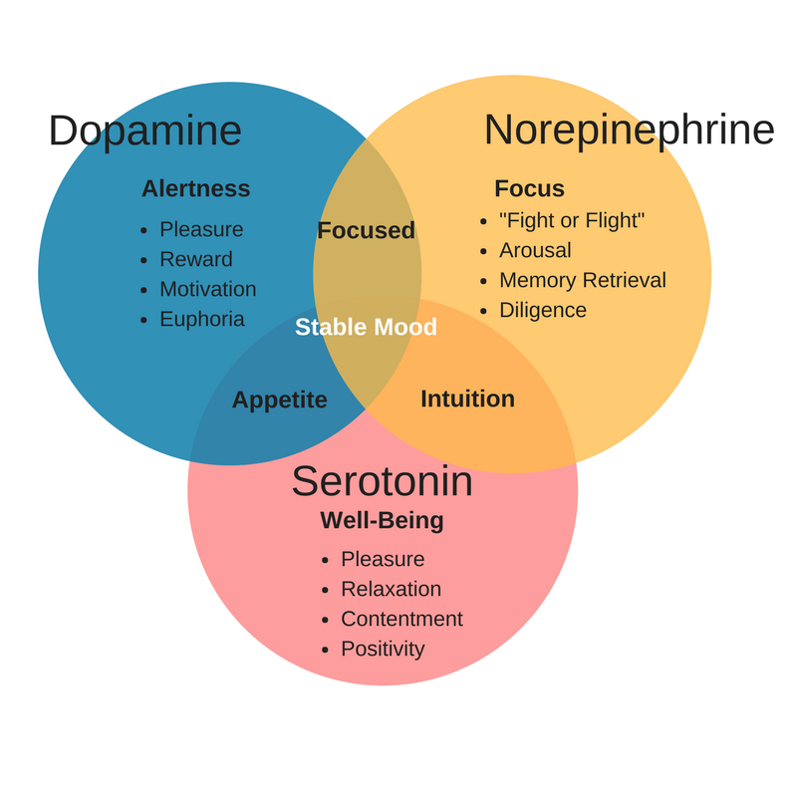
Neurotransmitters in brain and their functions

Slide 26
Etiology of Schizophrenia
3):-ENVIRONMENTAL/SOCIAL RISK FACTORS.
Potential psychosocial risk factors include:
i).CHILDHOOD ADVERSITY:-
May take the form of:-
-Emotional abuse
-Physical abuse
-Sexual abuse
-Child neglect
-Death of one or both parents.
Migration, especially becoming a member of a lower social-economic ethnic minority in an affluent nation/community.
Any major stressful life events.

Slide 27
Etiology of Schizophrenia cont…
Environmental/Social risk factors cont..
ii).ILLICIT SUBSTANCE USE.
Drugs that cause/disturbilize dopamine activity(increased or decreased) (cocaine,marijuana,amphetamines etc.)
can cause psychotic symptoms similar to those in schizophrenia.
Studies show that greater proportion of patients with schizophrenia use illicit drugs than in general population.

Slide 28
Environmental/Social risk factors cont..
ILLICIT SUBSTANCE USE CONT…
Although illicit drugs can cause psychotic symptoms, they are unlikely to “cause” schizophrenia, but in vulnerable indivinduals,they can:-
i):-Bring forward the age of onset of schizophrenia.
ii):-interfere with effectiveness of anti psychotics.
iii):-Can increase the frequency of relapses in patients with schizophrenia.
iii). CHILD UPBRINGING “SCHIZOPHRENIC MOTHER”
According to this theory, a mother can predispose /increase the risk of schizophrenia in her offspring by her attitude towards the offspring.
E.g.. Being dominant and overprotective ,but also rejecting and insensitive (Maternal dominance).

Slide 29
Environmental/Social risk factors cont..
Another related theory “Double bind hypothesis "says that schizophrenia can be predisposed when a child is being given contradicting messenges that put him into a “bind", resulting in schizophrenia.
However any person (close carer)with whom the patient lives can cause psychological harm by exhibiting high expressed emotions on the child.

Slide 30
DSM 5 Diagnostic criteria for schizophrenia
Characteristic symptoms:-
positive symptoms
Two (or more) of the following, each present for a significant portion of the time during a 1-month period (or less if successfully treated):
i):- delusions
ii):- hallucinations
iii):- disorganized speech/thinking (e.g. frequent derailment or incoherence)
iv):- grossly disorganized or catatonic behaviour.(motor activity).

Slide 31
Conti..
2. negative symptoms, i.e (5As).
i):-affective flattening,
ii):-alogia or
iii):-avolition.
iv):-annehedonia/associality
v):-Attention deficit.
Note:- Only one criterion 1 symptom is required if delusions are bizarre e.g. (Persecutory or grandiose delusions) or hallucinations consist of a voice keeping up a running commentary on the person’s behavior or thoughts, or two or more voices conversing with each other.

Slide 32
Conti..
2. Social/occupational dysfunction:- for a significant portion of the time since the onset of the disturbance, one or more major areas of functioning such as work, interpersonal relations, or self-care are markedly below the level achieved prior to the onset
OR
when the onset is in childhood or adolescence, failure to achieve expected level of:-
interpersonal,
academic, or
occupational achievement).

Slide 33
CONT……
Duration:- Continuous signs of the disturbance persist for at least 6months.
This 6-month period must include at least 1month of symptoms (or less if successfully treated) that meet criterion 1 (i.e., active-phase symptoms) and may include periods of prodromal or residual symptoms.

Slide 34
Subtypes of Schizophrenia (ICD -10).
1):-Paranoid
Onset usually in the late 20s to 30s.
People who develop this disorder usually function well before the onset of the disorder (good premorbid functioning).
Paranoia (any intense and strongly defended irrational suspicion) is the main characteristic and the main defense is projection.
Hallucinations, delusions, and ideas of reference are dominant.

Slide 35
2):-Disorganized schizophrenia-(formerly hebephrenic)..
The most regressed and socially impaired of all the schizophrenias.
The person has highly disorganized speech and behavior and inappropriate affect.
Bizarre mannerisms include grimacing along with other oddities of behavior.

Slide 36
3):-Catatonic schizophrenia.
The essential feature is abnormal motor behavior.
Two extreme motor behaviors are seen in catatonia.
One extreme is psychomotor agitation, which can lead to exhaustion.
The other extreme is psychomotor retardation and withdrawal to the point of stupor.
Onset is usually acute, and prognosis is good with medications and swift interventions.
Other behaviors may include autism, waxy flexibility and negativism.

Slide 37
4):-Undifferentiated (mixed type)
Clients experience active hallucinations and delusions, but no one clinical picture dominates (e.g. not paranoid, catatonic, or disorganized; rather the clinical picture is one of a mixture of symptoms).
Residual schizophrenia.
A person who is referred to as having residual schizophrenia no longer has active symptoms of the disease, such as delusions, hallucinations, or disorganized speech and behaviors.

Slide 38
Conti..
However, there is a persistence of some symptoms:-
For example:-
marked social withdrawal;
impairment in role function (wage earner, student, or homemaker);
eccentric behavior or odd beliefs;
poor personal hygiene;
lack of interest, energy, initiative and inappropriate affect.

Slide 39
Assessment alerts
Assessing positive symptoms
Assess for command hallucinations (e.g.., voices telling the person to harm self or another). If yes:
Do you plan to allow the command?
Do you believe the voices are real?
Assess if the client has fragmented, poorly organized, well-organized, systematized or extensive system of beliefs that are not supported by reality (delusions). If yes.

Slide 40
Cont…Assessment alerts
Assess if delusions have to do with someone trying to harm the client, and if the client is planning to retaliate against a person or organization.
Assess if precautions need to be taken.
3. Assess for pervasive suspiciousness about everyone and their actions, for example:
- is on guard, hyper alert, vigilant
- blames others for consequences of own behavior

Slide 41
Conti.. Assessment alerts
If patient Is hostile, argumentative often threatening verbalizations or violent behavior.
Assessing negative symptoms
Assess for negative symptoms of schizophrenia
Assess support system:-
Is family well informed about the disease (e.g., schizophrenia)?
Does family understand the need for medication adherence?
Is family familiar with family support groups in the community, or where to go for respite and family support?

Slide 42
Assessing for suicide risk.
Patients with acute schizophrenia especially males are at increased risk of suicide.
Some suicide risk assessment tools include the following:-
-SADPERSONS Risk assessment tool.
-Beck depression inventory
-NIMS:-National institute of mental illness assessment tool.
-Beck anxiety assessment tool.

Slide 43
Assessing for violence.
Small proportion of patients (usually young males) may pose risk of violence to others self and others.
Following Symptoms may indicate an increased risk to violence:-
Command hallucinations-ordering patients to harm themselves or others.
Delusional believes of being controlled by others.
History of violence ,comorbid alcohol/substance misuse, on-compliance with medication,anti social personality, poor insight etc.
NB:-
Patients are more likely to be victims of violence rather than perpetrators.

Slide 44
INVESTIGATIONS.
Routine blood tests done before initiating treatment:-
Complete blood counts
Liver function tests
Urea and electrolytes
glucose tests,
lipid tests.
2.Baseline ECG.
3.Urine for drug screening.
NB:-
Some anti psychotics may increase glucose and lipid levels.
Blood tests and ECG should be done atleast once every 1-2 years.

Slide 45
MANAGEMENT OF SCHIZOPHRENIA.
TREATMENT GOALS:-
Successful schizophrenia treatment should have following goals:-
1.Should aim at building functional capacity on the client.
2.Aim at improving the quality of life of the patient.
3.Lead to subjective well being of the patient.
4.Aim at building an alliance between therapist and patient for purposes of increasing adherence.
5.Should have tolerability-patient should be able to tolerate the treatment regimen.
6. Should have efficacy:-The ability to produce the desired or intended results.

Slide 46
OVERVIEW OF ANTI PSYCHOTIC DRUGS.
Antipsychotic drugs.
Drugs used in treatment of psychotic disorders and psychotic symptoms.
Also known as major tranquilizers,neuroleptics,anti-schizophrenics drugs and D2 –receptor blockers.
Classified into :-
i):-1st generation antipsychotics aka typical/conventional antipsychotics.
ii):-2nd generation antipsychotics aka Atypical anti psychotics.

Slide 47
1st generation antipsychotics
Also known as typical/conventional antipsychotics.
Examples :-
- chlorpromazine(CPZ)
-Haloperidol
-Fluphenazine
-Thioridazine/Melaril
-Flupentixol
-Stelazine.

Slide 48
2nd generation antipsychotics.
Also known as Atypical anti psychotics.
Examples:- (CLOQZAC-acronym)
-Clozapine
-Olanzapine
-Lozepine
-Quitipine
-Ziprasidone
- Risperidone
-Aripiprazole

Slide 49
Rationale for using anti psychotics in schizophrenia.
According to dopamine theory of schizophrenia, schizophrenia is due to excess dopamine in the brain.
So by decreasing the activity of dopamine, schizophrenia can be treated.
Anti psychotics act by blocking post synaptic dopamine receptors in brain, thus preventing dopamine from exerting its action.

Slide 50
Standard medications
The standard antipsychotic drugs target the more flagrant symptoms of schizophrenia (hallucinations, delusions, suspiciousness, associative looseness).
These drugs can:-
Reduce disruptive and violent behaviour
Increase activity, speech and sociability in withdrawn clients
Improve self-care
Improve sleep patterns

Slide 51
Conti.
Reduce the disturbing quality of hallucinations and delusions
Improve thought processes
Decrease resistance to supportive therapy
Reduce rate of relapse
Decrease intensity of paranoid reactions
Antipsychotic agents are usually effective 3-6 wks after the regimen is started

Slide 52
PROGNOSIS.
Good prognostic factors:-
Female gender
Acute onset
Clear precipitating factors
Prominent affective symptoms
Early initiation of treatment
Good occupational adjustments
Stable family factors.

Slide 53
Prognosis.
Rule of thirds:-
1/3 will recover completely.
1/3 will improve over time
1/3 will NOT show any improvement.
Rule of quarters:-
About 25% recover completely and do not need long term treatment.
About 25% show good improvement with treatment and are able to function independently.
About 25% show good improvement with treatment, but also need a lot of support.
Remaining 25% do not show improvement.

Slide 54
Prognosis.
Reasons for early death.
Suicide –about10% commit suicide.
Mostly male patients in the early course of treatment.
Lifestyle factors:-e.g. smoking, lack of exercises.
Effect of acute symptoms:-Patient may not cooperate with treatment, accidents, violence etc.
Chronic lack of motivation:-patient does not seek help for physical problems.
Discrimination:-By medical professionals (may not be deliberate)
Side effects of medication:-e.g. diabetis,weight gain, raised lipids etc.

Slide 55
OTHER PSYCHOTIC DISORDERS
1):-Schizophreniform disorder
The essential features of this disorder are exactly those of schizophrenia except that:
The total duration of the illness is at least 1month but less than 6 months.
Impaired social or occupational functioning during some part of the illness is not apparent (although it may appear).
This disorder may or may not have a good prognosis.

Slide 56
2):-Brief psychotic disorder
This is a disorder in which there is a sudden onset of psychotic symptoms (delusions, hallucinations, disorganized speech) or grossly disorganized or catatonic behaviour.
The episode lasts at least 1day but less than 1 month, and then the individual returns to his or her premorbid level of functioning.
Brief psychotic disorders often follow extremely stressful life events

Slide 57
3):-Schizoaffective disorder
This disorder is characterized by an uninterrupted period of illness during which time there is a major depressive, manic or mixed episode,
concurrent with
symptoms that meet the criteria for schizophrenia.
The symptoms must not be due to any substance use of abuse or general medical condition.

Slide 58
4):-Delusional disorder
This disorder involves non-bizarre delusions (situations that occur in real life, such as:-
Being followed, interfered with etc.
Infected by a spouse or fear to engage in intimate relations.
loved at a distance, by important people
deceived by a spouse, or having a disease)
Duration:- at least 1month’s duration.
The person's ability to function is not markedly impaired, nor is the person’s behaviour obviously odd or bizarre.
Common types of delusions seen in this disorder are delusions of grandeur, persecution, or jealousy, or somatic or mixed delusions.

Slide 59
5):-Induced or secondary psychosis
Psychosis may be induced by substances (drugs of abuse, alcohol, medications, or toxin exposure) or caused by the physiological consequences of a general medical condition (delirium, neurological conditions, metabolic conditions, hepatic or renal diseases, and many more).
Medical conditions and substances of abuse must always be ruled out before a primary diagnosis of schizophrenia or other psychotic disorder can be made.

